Slide 1
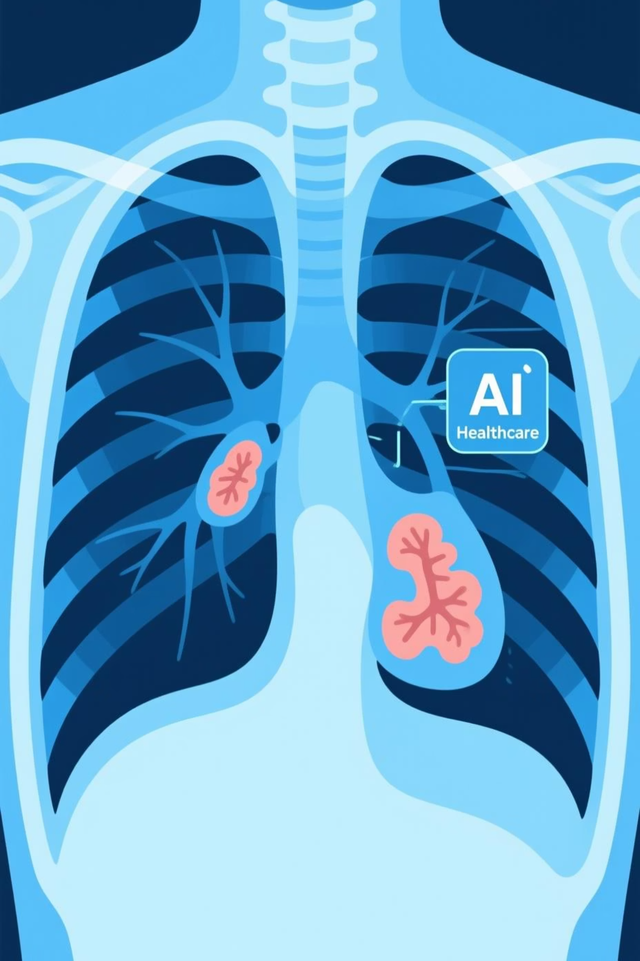
Pneumonia Detection from Chest X-rays Using Python, HTML, CSS & JavaScript
Leveraging deep learning and web technologies to revolutionise early diagnosis and save lives through automated medical image analysis.

Slide 2
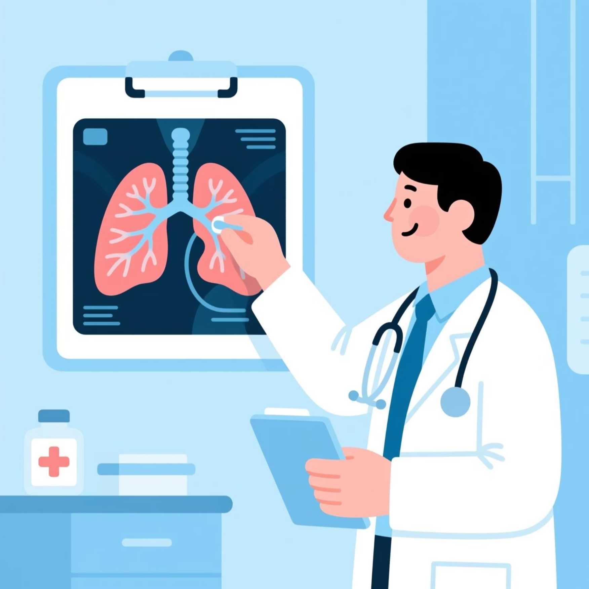

Introduction to Pneumonia Detection
Pneumonia remains one of the leading causes of mortality worldwide, particularly amongst children and elderly populations. Early and accurate diagnosis is absolutely critical for effective treatment and improved patient outcomes.
Chest X-rays serve as the primary diagnostic tool, but they require expert radiological analysis which can be time-consuming and subject to human variability.
Global Health Challenge
Expert Analysis Required
AI-Powered Solution
High mortality rates demand rapid diagnosis
Traditional methods rely on specialist availability
Automated detection using deep learning technology

Slide 3
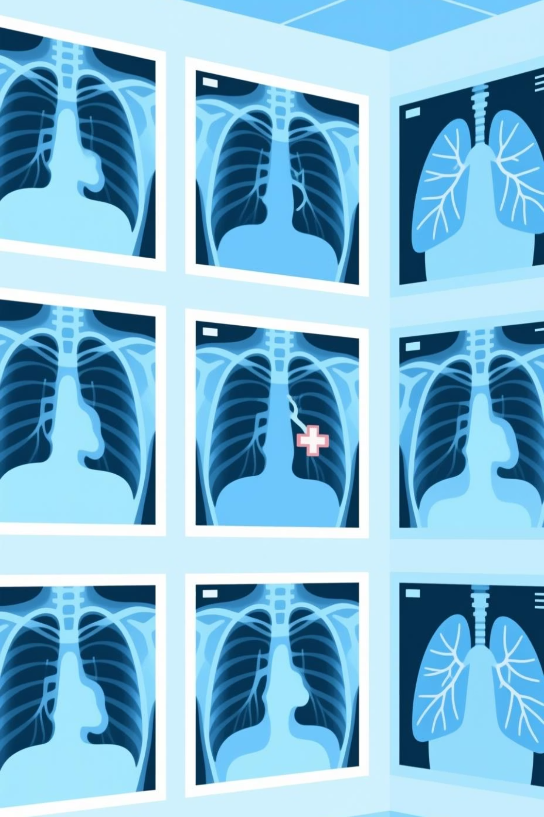
Dataset and Problem Statement
Data Source
Chest X-Ray Images dataset from Kaggle containing labelled Normal and Pneumonia cases for supervised learning
Dataset Size
Approximately 5,800 high-quality chest X-ray images split into training, validation, and testing sets
Classification Challenge
Accurately distinguish between pneumonia-affected lungs and healthy lung tissue in radiographic images
Project Goal
Develop a reliable, robust model to assist radiologists and healthcare workers in rapid diagnosis

Slide 4

Deep Learning Model Architecture
Built with Python & Advanced Frameworks
Our solution leverages powerful deep learning frameworks including PyTorch and TensorFlow to construct a sophisticated image classification system.
01
02
Custom CNN Architecture
Transfer Learning
Three convolutional layers with max pooling, followed by fully connected dense layers for feature extraction
Pre-trained models like VGG16 and Inception-V3 provide superior accuracy through knowledge transfer
03
Data Preprocessing
Image resizing, normalisation, and augmentation techniques including rotation and flipping enhance model robustness

Slide 5
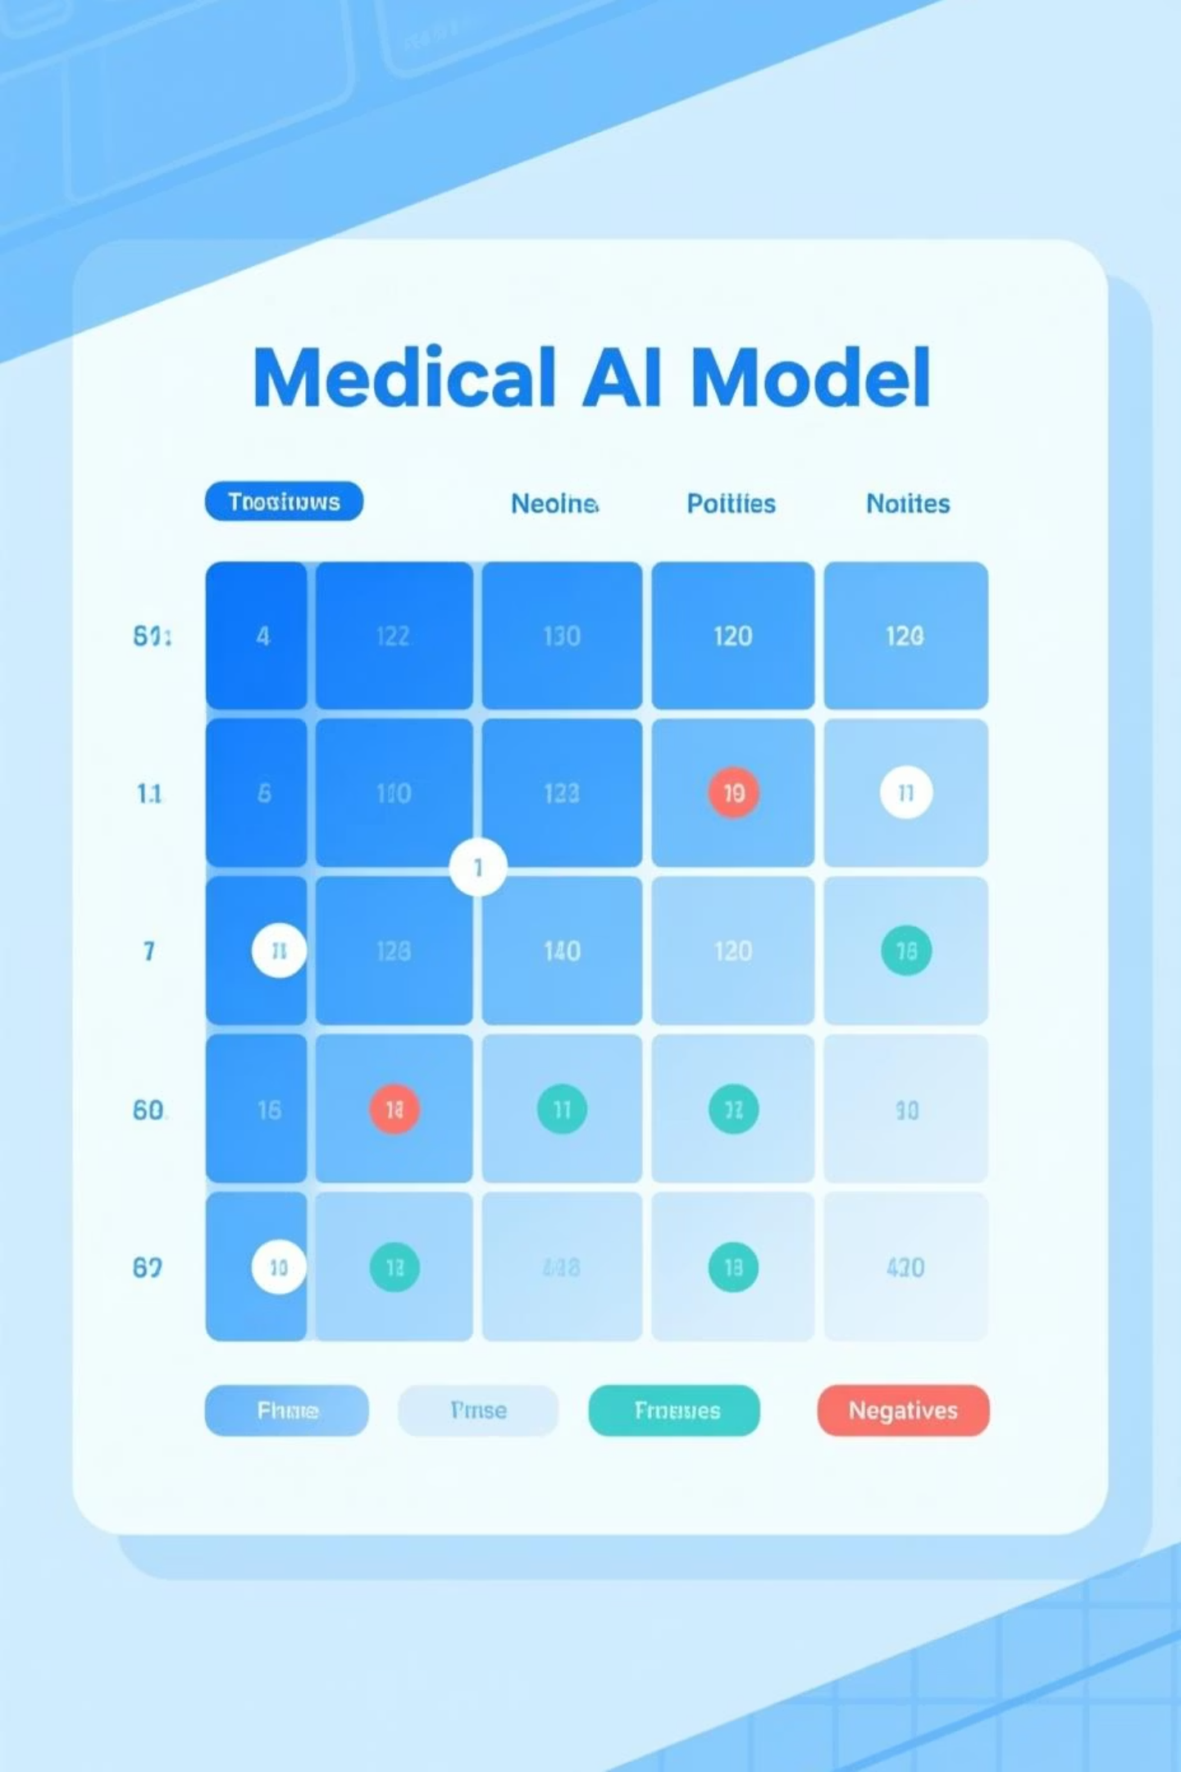
Model Training & Performance
90%
92%
4
Training Accuracy
Testing Accuracy
Key Metrics
Accuracy, Recall, Precision, AUC
Achieved during model learning phase
Performance on unseen data
Comprehensive confusion matrix analysis demonstrates the model's strong capability in detecting pneumonia cases whilst minimising false negatives. Model checkpoints are systematically saved throughout training for seamless deployment and future fine-tuning.

Slide 6
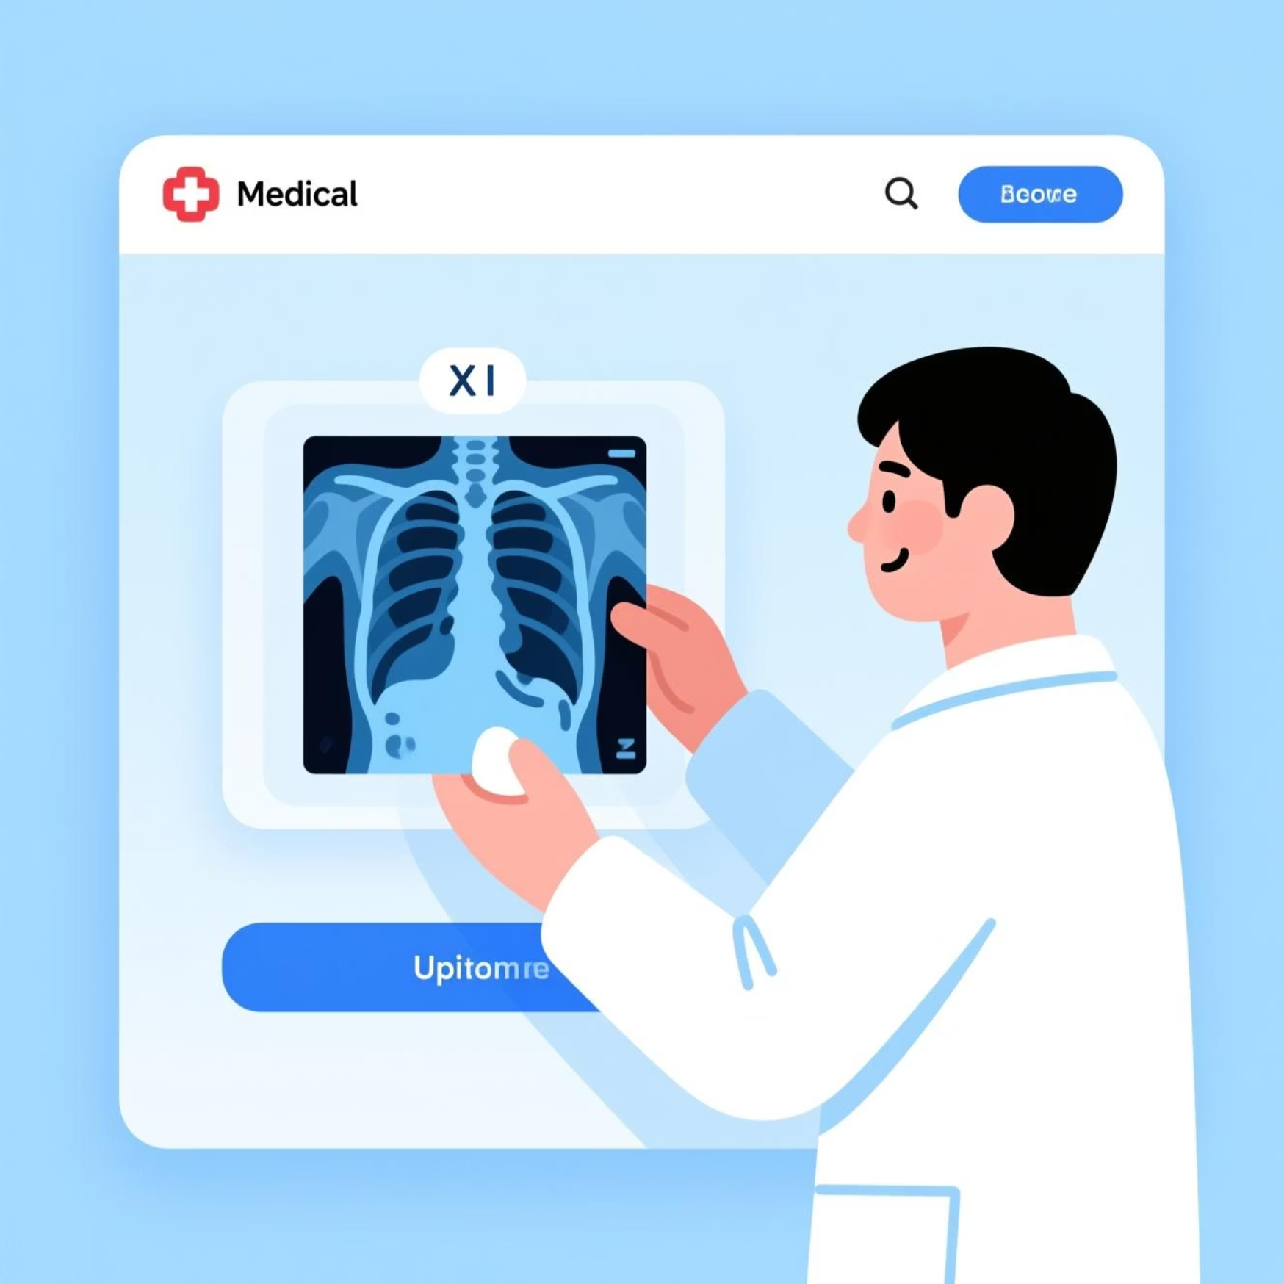



Web Application Interface
Modern Frontend Technologies
The application features a responsive, intuitive interface built with HTML5 and CSS3, ensuring accessibility across all devices and screen sizes.
JavaScript powers the interactive elements, handling secure image uploads, input validation, and asynchronous communication with the backend server.
Image Upload
Validation
Prediction Display
User-friendly drag-and-drop interface
Real-time file type and size checking
Instant results with confidence scores

Slide 7


Backend Integration & Deployment
1
Frontend Upload
User submits chest X-ray image through browser interface
2
API Communication
Image transmitted securely to Flask/Streamlit backend server
3
Model Inference
Deep learning model processes image and generates prediction
4
Result Delivery
Classification result returned with confidence metrics
Security First: All medical images are handled with AES-256 encryption to ensure patient privacy and full compliance with healthcare data protection regulations including HIPAA standards.

Slide 8

Live Demo & User Experience
Designed for Healthcare Professionals
The application provides a simple, intuitive interface tailored for both medical professionals and patients seeking preliminary screening.
Upload chest X-ray images instantly
Receive pneumonia predictions within seconds
View detailed probability scores and diagnostic suggestions
Access comprehensive result history and reports
Rapid Analysis
Visual Feedback
Future Ready
Results delivered in under 5 seconds per X-ray image
Clear probability scores with colour-coded confidence indicators
Architecture supports mobile apps and batch processing capabilities

Slide 9
Challenges & Future Enhancements
Current Challenges
Future Development Roadmap
Dataset Imbalance
Vision Transformers
Unequal distribution of pneumonia vs normal cases affects training
Implement ViT architecture for enhanced feature extraction capabilities
False Negatives
Dataset Expansion
Critical cases require zero tolerance for missed diagnoses
Include diverse demographics and imaging equipment for robustness
Generalisation
Edge Deployment
Model performance across diverse patient populations and X-ray equipment
Optimise model for faster inference on resource-constrained devices
Mobile Application
Develop cross-platform mobile app with offline diagnostic capabilities

Slide 10
Conclusion & Impact
"AI-driven pneumonia detection represents a transformative leap in accessible healthcare, with the potential to save countless lives through early, accurate diagnosis."
Life-Saving Technology
Accessible Healthcare
Scalable Solution
Early detection enables timely intervention and significantly improves patient survival rates across all demographics
Combining Python deep learning with web technologies creates tools accessible to healthcare facilities worldwide
Our project demonstrates a production-ready, accurate, and user-friendly system deployable at any scale
Join Us in Transforming Healthcare
We invite healthcare institutions, researchers, and technology partners to collaborate in deploying and continuously improving AI-powered diagnostic tools that make quality healthcare accessible to all communities globally.

